Slide 1
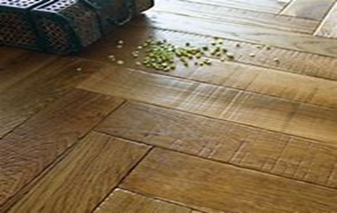
Flooring Maintenance
Video : Introduction to Flooring
https://youtu.be/-JtZY5o0U5M?si=E4OrR60QHnNX9Jjl

Slide 2
Flooring Maintenance
Safety in flooring.
1. Conduct a floor and walkways audit.
2. Wipe and organize work areas.
3. Repair problem areas.
4. Create floor cleaning and maintenance procedures
5. Establish foot-wear guidelines.
6. Implement slip, trip and fall prevention control.
7. Use containment and absorbents in areas wit regular leaks and drips.
8. Prepare for spills.
9. Use appropriate signage, barricades and lightning.
10. All learners must trained about floor safety.
Video :
https://youtu.be/0jQFmiWHWNE?si=VqWNmc4Nxj5aTGd0
Feedback : Activity

Slide 3
Kwa Thema Skills School
Subject : Maintenance Marks : 10
Grade : Year 1 Time : 30 mins
Date : / / 2024
Question :1 Safety rules 1. State whether the following statements are true or false. 1.1. Implement slip, trip and fall prevention control. ________ 1.2. Wipe and organise work areas. _________ 1.3. Conduct a floor and walkways audit. ________ 1.4. Use containment and absorbents in areas with regular leaks and drips. ________ 1.5. Establish footwear guidelines. _______ 1.6. Use appropriate signage, barricades and lightning. ________ 1.7. All learners must be trained about floor safety. _________ 1.8. Repair problem areas. __________ 1.9. Prepare for spills. ___________ 1.10. Use protective equipments for eyes, skin and ____________. (10)

